Slide 1
Refactoring-III
Bad Smells in Code

Slide 2
Inline Temp
Problem: You have a temporary variable that’s assigned a result of simple expression & nothing more.
Solution: Replace the references to the variable with the expression itself.
Benefits
You can marginally improve the readability of the program by getting rid of the unnecessary variable.
boolean hasDiscount(Order order) {
double basePrice = order.basePrice();
return basePrice > 1000;
}
boolean hasDiscount(Order order) {
return order.basePrice() > 1000;
}

Slide 3
Replace Temp with Query
Problem: You place the result of an expression in a local variable for later use in your code.
Solution: Move the entire expression to a separate method and return the result from it. Query the method instead of using a variable. Incorporate the new method in other methods, if necessary.
double calculateTotal() {
if (basePrice() > 1000) {
return basePrice() * 0.95;
}
else {
return basePrice() * 0.98;
}
}
double basePrice() {
return quantity * itemPrice;
}
double calculateTotal() {
double basePrice = quantity * itemPrice;
if (basePrice > 1000) {
return basePrice * 0.95;
}
else {
return basePrice * 0.98;
}
}

Slide 4
Split Temporary Variable
Problem: have a temporary variable assigned to more than once, but is not a loop variable nor a collecting temporary variable.
Solution: Make a separate temporary variable for each assignment.
double temp = 2 * (height + width);
System.out.println(temp);
temp = height * width;
System.out.println(temp);
final double perimeter = 2 * (height + width);
System.out.println(perimeter);
final double area = height * width;
System.out.println(area);

Slide 5
Remove Assignments to Parameters
Problem: Some value is assigned to a parameter inside method’s body.
Solution: Use a local variable instead of a parameter.
int discount(int inputVal, int quantity) {
if (inputVal > 50) {
inputVal -= 2;
}
// ...
}
int discount(int inputVal, int quantity) {
int result = inputVal;
if (inputVal > 50) {
result -= 2;
}
// ...
}

Slide 6
Replace Method with Method Object
Problem: You have a long method that uses local variables in such a way that you cannot apply Extract Method
Sol: Transform the method into a separate class so that the local variables become fields of the class. Then you can split the method into several methods within the same class.

Slide 7
Bad Smells in Code
Parallel Interface Hierarchies
Lazy Class
Speculative Generality
Temporary Field
Message Chains
Middle Man
Inappropriate Intimacy
Incomplete Library Class
Data Class
Refused Bequest
Duplicated Code
Long Method
Large Class
Long Parameter List
Divergent Change
Shotgun Surgery
Feature Envy
Data Clumps
Primitive Obsession
Switch Statements

Slide 8
Few solutions to Bad Smells
Duplicated Code
If you see the same code structure in more than one place, you can be sure that your program will be better if you find a way to unify them.
solution: perform EXTRACT METHOD and invoke the code from both places.
Long Method
The longer a procedure is the more difficult it is to understand.
solution: perform EXTRACT METHOD or Decompose Conditional or Replace Temp with Query.

Slide 9
Large class
When a class is trying to do too much, it often shows up as too many instance variables.
solution: perform EXTRACT CLASS or SUBCLASS
Long Parameter List
With objects you don't need to pass in everything the method needs, instead you pass in enough so the method can get to everything it needs
solution: Use REPLACE PARAMETER with METHOD when you can get the data in one parameter by making a request of an object you already know about.

Slide 10
Shotgun Surgery
This situation occurs when every time you make a kind of change, you have to make a lot of little changes to a lot of different classes.
solution: perform MOVE METHOD/FIELD or INLINE Class bring a whole bunch of behavior together.
Feature Envy
It is a method that seems more interested in a class other in the one that it is in.
solution: perform MOVE METHOD or EXTRACT METHOD on the jealous bit and get it home.

Slide 11
Switch Statements
They are generally scattered throughout a program. If you add or remove a clause in one switch, you often have to find and repair the others too.
solution: Use EXTRACT METHOD to extract the switch statement and then MOVE METHOD to get it into the class where the polymorphism is needed.

Slide 12
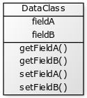
Data Classes
Data Classes are classes, which only contain fields, getters and setters. Or even worse: only public fields. They are just dumb data holders.
Are they really so bad?
When you do some quick prototyping and need to store and transfer data without too much coding effort, they are sometimes a good compromise.
But when your project grows, you should fix this to accomplish one major goal of object orientation: Low Coupling between classes.

Slide 13
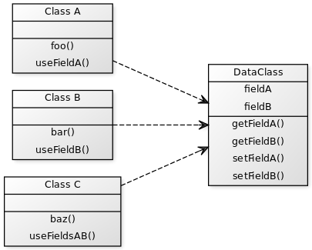
Data Classes
But when your project grows, you should fix this to accomplish one major goal of object orientation: Low Coupling between classes. You want as few dependencies between your classes as possible. But currently everything that’s done with your data, is done in other classes:
Everyone but the Data Class itself uses its data. This results in high coupling.

Slide 14
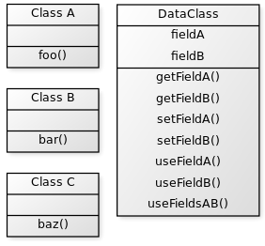
Data Classes
What to do about it?
To achieve a low coupling and a high cohesion you need to put the methods in the classes they’re working on most. If you already introduced a Data Class you either need to move the methods closer to the fields or vice versa:
Moving the methods into the Data Class itself eliminates the dependencies.

Slide 15
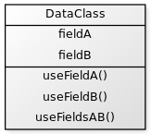
Data Classes
If no more class accesses the fields, you can even remove their getters and setters and leave them private:
Now our DataClass no longer smells like a Data Class. We reduced the coupling and from this point we could change the ex-DataClass without effecting the other classes. Enjoy your great code

Slide 16
What is Feature Envy?
Feature Envy is a Code Smell which occurs in methods. A method has Feature Envy on another class, if it uses more features (i.e. fields and methods) of another class than of its own.
Jdeodorant is an eclipse plugin, which promises finding feature envy and visualizing it. I wanted to use it for a simple example, but the plugin didn’t work properly.
https://marketplace.eclipse.org/content/jdeodorant
https://www.youtube.com/watch?v=LtH8uF0epV0
JDeodorant: Code Smell Visualization Demo

Slide 17
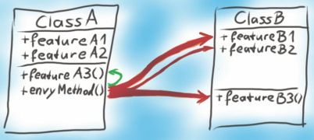
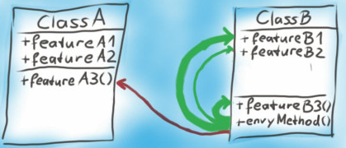
Feature Envy
Displaying the dependencies of a method.
Thicker arrows mean more uses of the same feature.
After moving the envy method to the desired class, the green arrows total thickness exceed the others. We have no more Feature Envy.

Slide 18
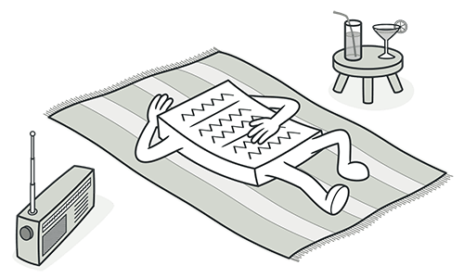
Lazy Class
Signs and Symptoms
Understanding and maintaining classes always costs time and money. So if a class doesn’t do enough to earn your attention, it should be deleted.

Slide 19
Lazy Class
Reasons for the Problem
Perhaps a class was designed to be fully functional but after some of the refactoring it has become ridiculously small.
Or perhaps it was designed to support future development work that never got done.
Treatment
Components that are near-useless should be given the Inline Class treatment.
For subclasses with few functions, try Collapse Hierarchy.

Slide 20
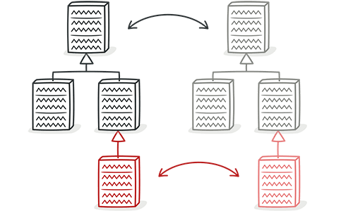
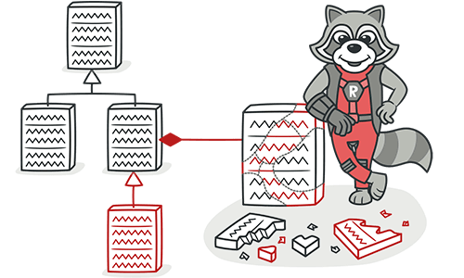
Parallel Inheritance Hierarchies
Signs and Symptoms
Whenever you create a subclass for a class, you find yourself needing to create a subclass for another class.
Reasons for the Problem
All was well as long as the hierarchy stayed small. But with new classes being added, making changes has become harder and harder.
Treatment Move Method and Move Field.
Notes:
Treatment
You may de-duplicate parallel class hierarchies in two steps. First, make instances of one hierarchy refer to instances of another hierarchy. Then, remove the hierarchy in the referred class, by using Move Method and Move Field.

Slide 21
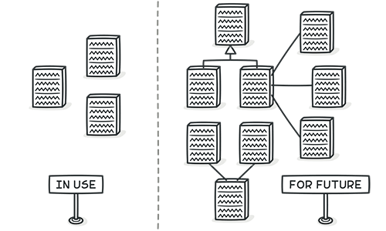
Speculative Generality
Signs and Symptoms
There’s an unused class, method, field or parameter.
Reasons for the Problem
code is created “just in case” to support anticipated future features that never get implemented. As a result, code becomes hard to understand and support.

Slide 22
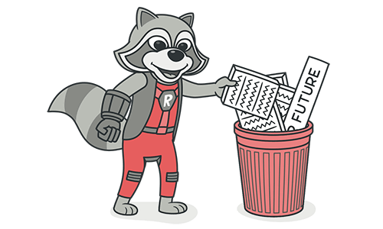
Speculative Generality
Treatment
Unused abstract classes -> Collapse Hierarchy.
Unnecessary delegation of functionality to another class can be eliminated via Inline Class.
Unused methods? -> Inline Method to get rid of them.
Methods with unused parameters -> Remove Parameter.
Unused fields can be simply deleted.
Notes:
Treatment
For removing unused abstract classes, try Collapse Hierarchy.
Unnecessary delegation of functionality to another class can be eliminated via Inline Class.
Unused methods? Use Inline Method to get rid of them.
Methods with unused parameters should be given a look with the help of Remove Parameter.
Unused fields can be simply deleted.

Slide 23
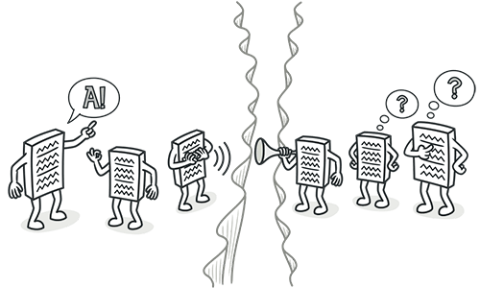
Message Chains
Signs and Symptoms
In code you see a series of calls resembling
$a->b()->c()->d()
Reasons for the Problem
A message chain occurs when a client requests another object, that object requests yet another one, and so on. These chains mean that the client is dependent on navigation along the class structure. Any changes in these relationships require modifying the client.

Slide 24
Message Chains
Treatment
To delete a message chain, use Hide Delegate.
Sometimes it’s better to think of why the end object is being used. Perhaps it would make sense to use Extract Method for this functionality and move it to the beginning of the chain, by using Move Method.

Slide 25
Benefits of Refactoring
Refactoring is useful to any program that has at least one of the following shortcomings:
Programs that are hard to read are hard to modify.
Programs that have duplicate logic are hard to modify

Slide 26
Continued…
Programs that require additional behavior that requires you to change running code are hard to modify.
Programs with complex conditional logic are hard to modify.

Slide 27
Refactoring Risks
Introducing a failure with refactoring can have serious consequences.
When done on a system that is already in production, the consequences of introducing bugs without catching them are very severe.

Slide 28
Costs of Refactoring
Language / Environment :
Depends on how well the operations on the source code are supported. But in general the cost of applying the basic text modifications should be bearable.
Testing :
Relies heavily on testing after each small step and having a solid test suite of unit tests for the whole system substantially reduces the costs which would be implied by testing manually

Slide 29
Continued…
Documentation :
Costs of updating documentation of the project should not be underestimated as applying refactorings involves changes in interfaces, names, parameter lists and so on.
All the documentation concerning these issues must be updated to the current state of development.

Slide 30
Continued…
System :
The tests covering the system need an update as well as the interfaces and responsibilities change. These necessary changes can contribute to higher costs as tests are mostly very dependent on the implementation.

Slide 31
When to put Off Refactoring ?
Concerned code is neither able to compile or to run in a stable manner, it might be better to throw it away and rewrite the software from scratch.
When a deadline is very close. Then it would take more time to do the refactoring than the deadline allows.

